Slide 1



Hotel Data Analysis Project
By NAVEEN BANSAL

Slide 2
OBJECTIVES
Is the hotel revenue growing by year?
Should the hotel increase the parking lot size?
What trends can we see in the data?

Slide 3

Data analysis project pipeline
Build a database
Develop the SQL Query
Connect Power BI to the database
Visualize
Summarize findings.

Slide 4

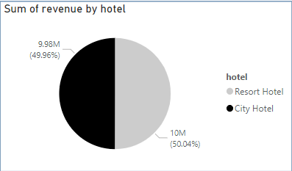
Revenue By Hotel Type
Both Resort Hotel and City Hotel has around 50% of revenue

Slide 5
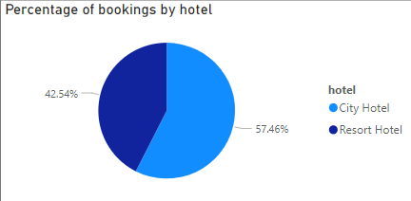
Percentage of bookings by hotel
Even though both hotels has the same revenue,
Resort hotel did so with lesser number of bookings!
It clearly shows Resort hotels have higher revenue per booking.

Slide 6

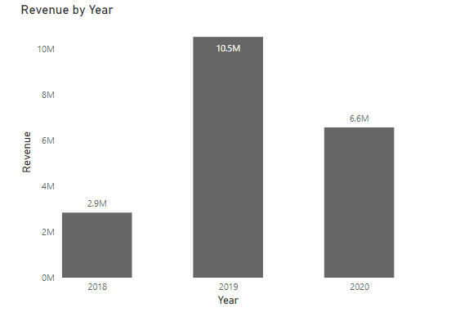
Is the revenue growing every year in the hotel Industry?
Even though the revenue grew 4 folds from 2018 to 2019, the revenue took a dive in 2020.
The most probable reason for this downtrend is the covid lockdowns that happened throughout the world.

Slide 7
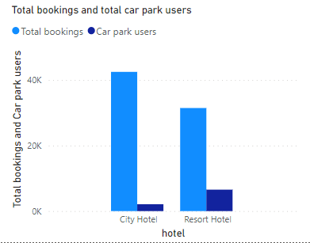
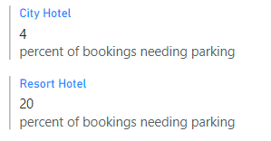
Percentage of parking used by hotel type
20% of bookings that happen in resort hotels need parking while only 4% of bookings that happen in city hotels need parking.

Slide 8
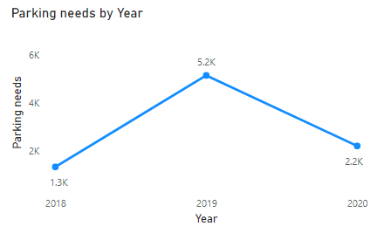
Parking needs trend by year
Again, we see a 4 fold increase in the parking needs from 2018 to 2019, but the pandemic lowers it down.

Slide 9

Conclusion
Resort Hotels typically have higher revenue per customer than other hotels.
Resort hotels also have more parking needs than other type of hotels
Prior to the onset of the pandemic, the industry was experiencing significant growth.
We don’t need more parking spaces, for now!

